Slide 1
FIRST PRESENTATION
BB

Slide 2
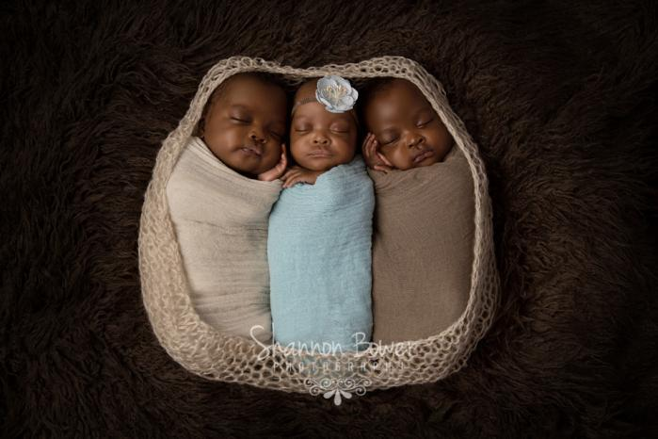
HTML /CSS
CLI / GIT
JavaScript

Slide 3
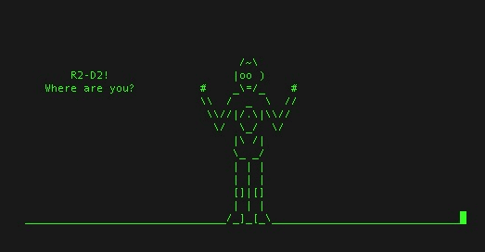

Slide 4
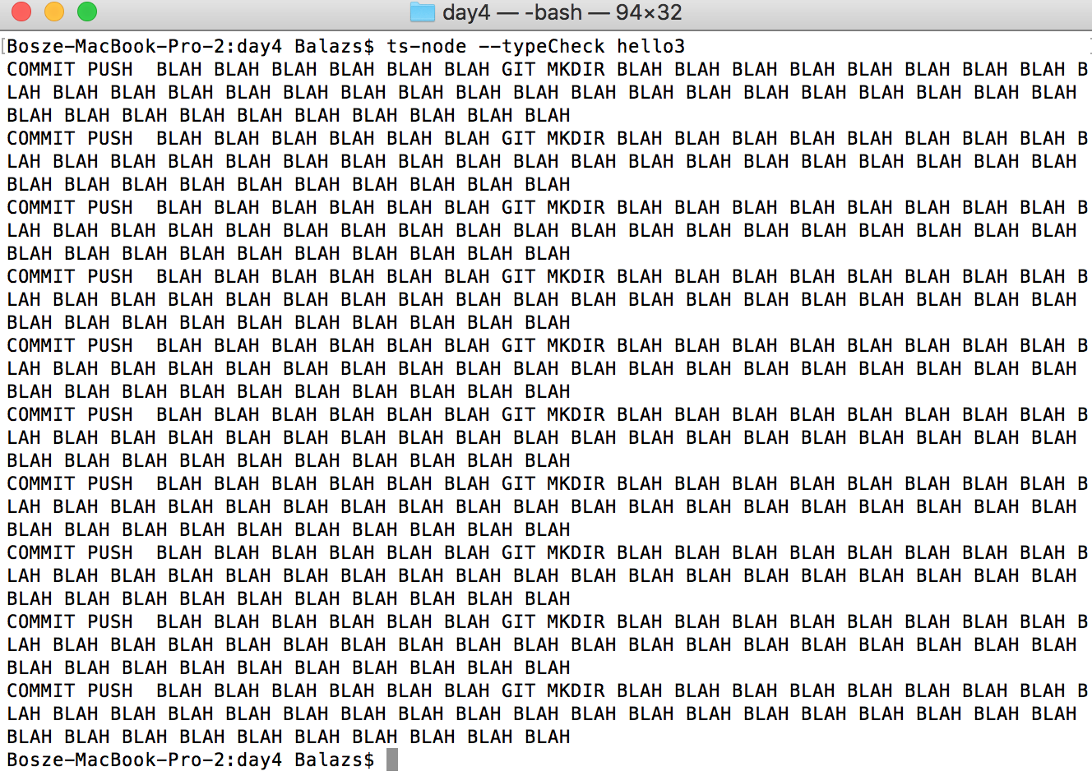

Slide 5
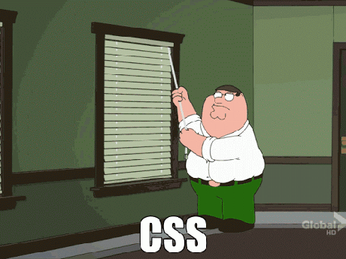

Slide 6
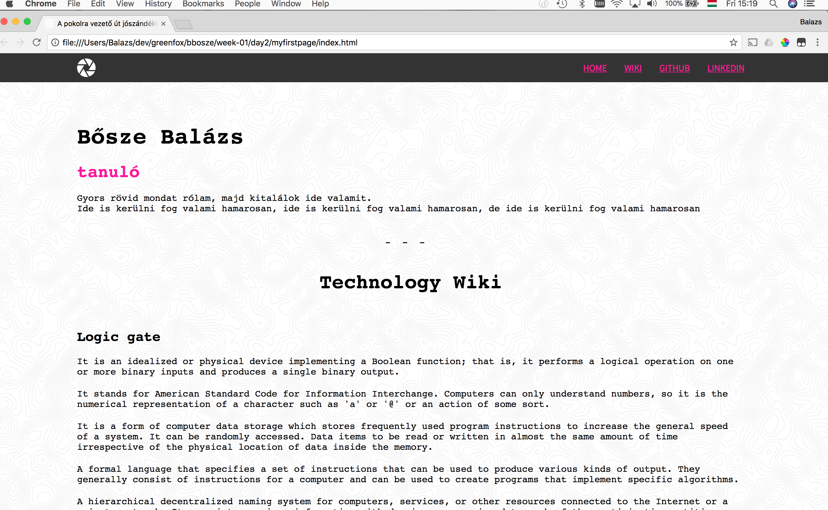

Slide 7
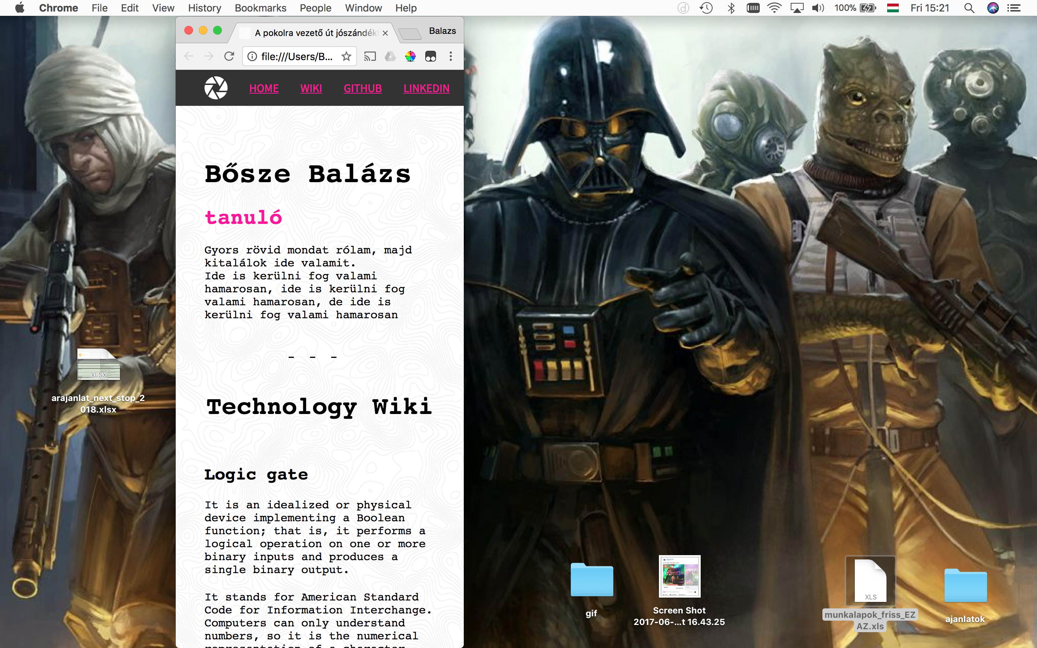

Slide 8
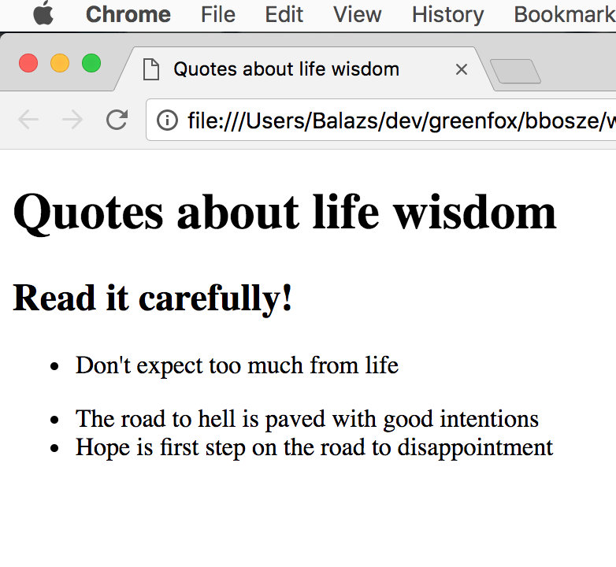

Slide 9

ANOTHER SEPARATING SLIDE

Slide 10
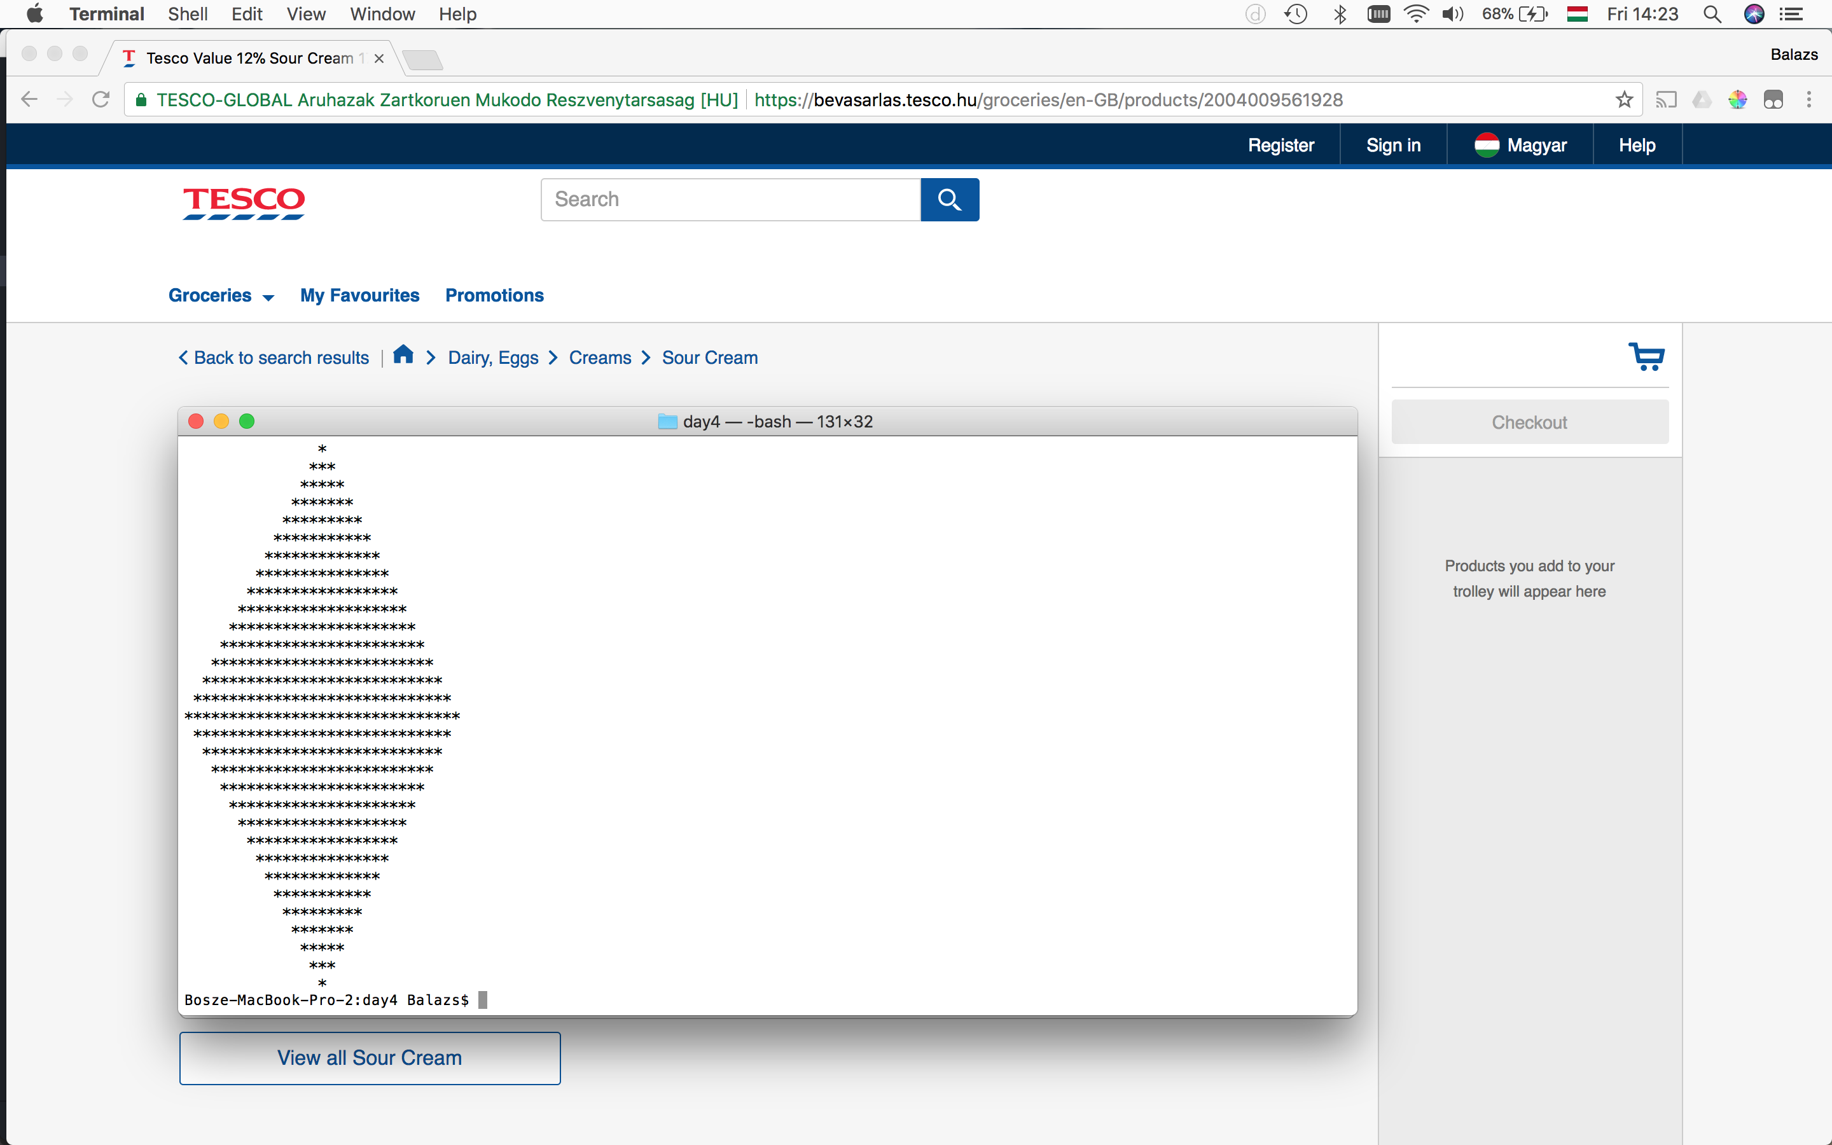
ONLY ODD NUMBERS
NO EVEN NUMBERS

Slide 11
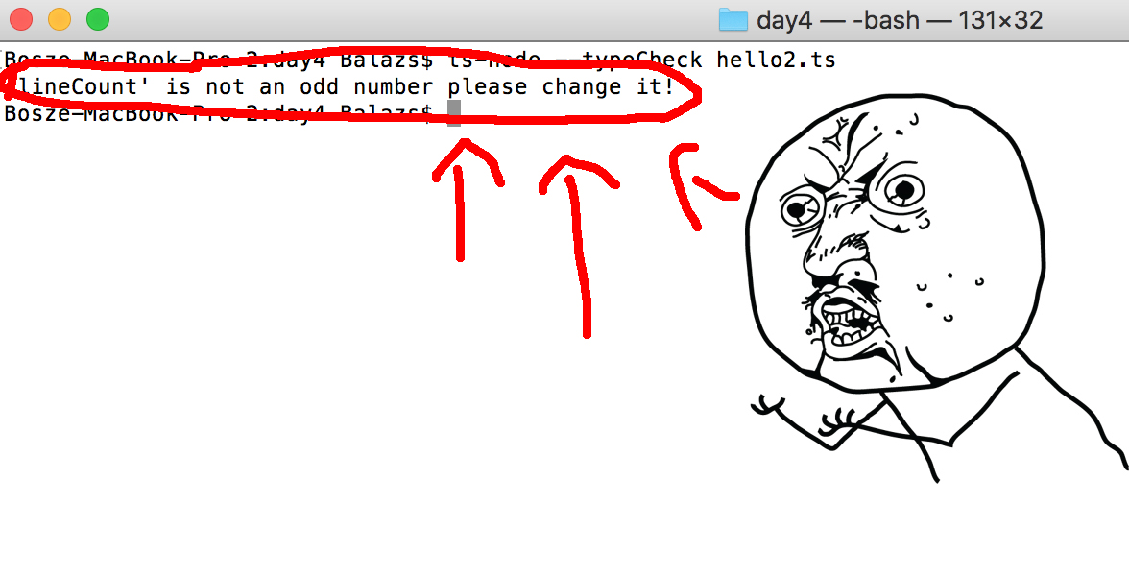

Slide 12
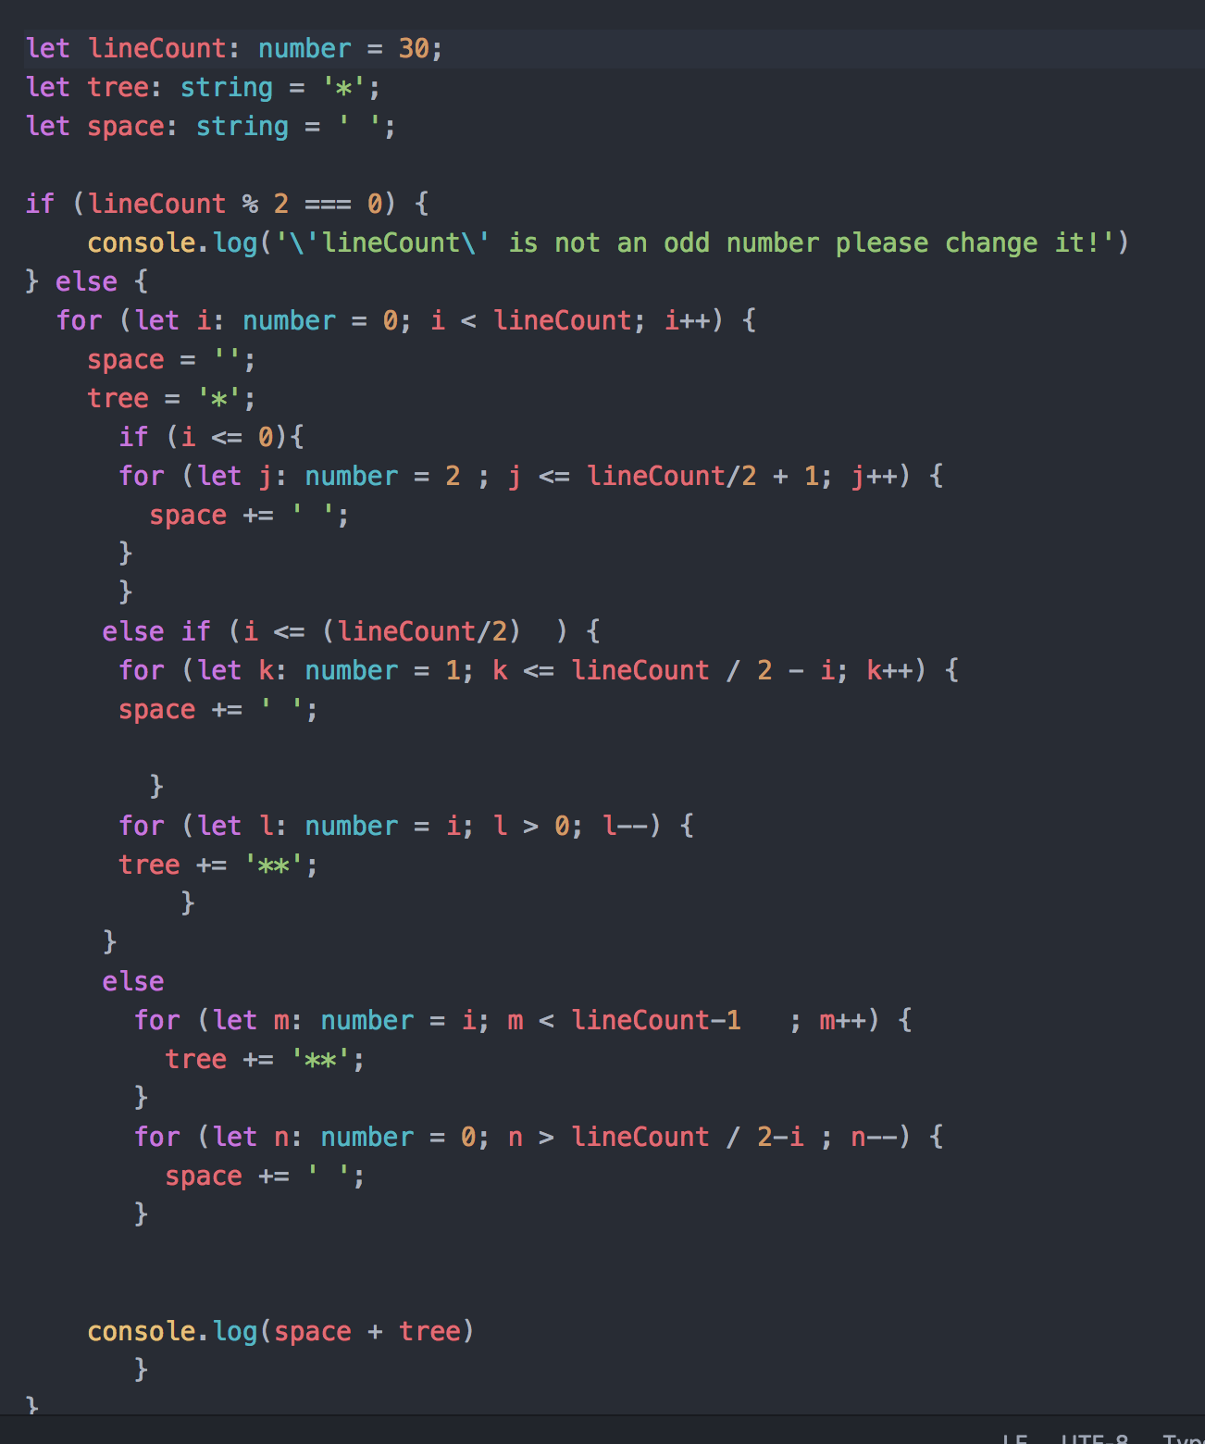

Slide 13
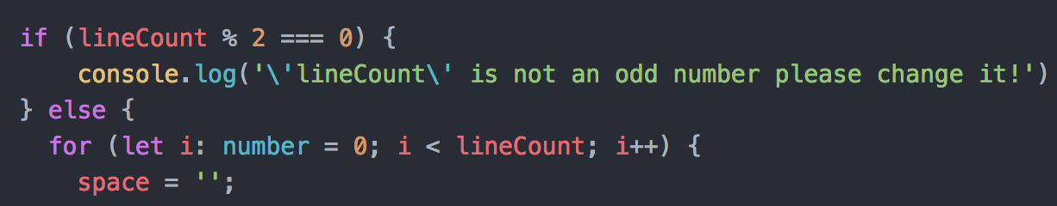
DIAMOND OR ERROR?

Slide 14
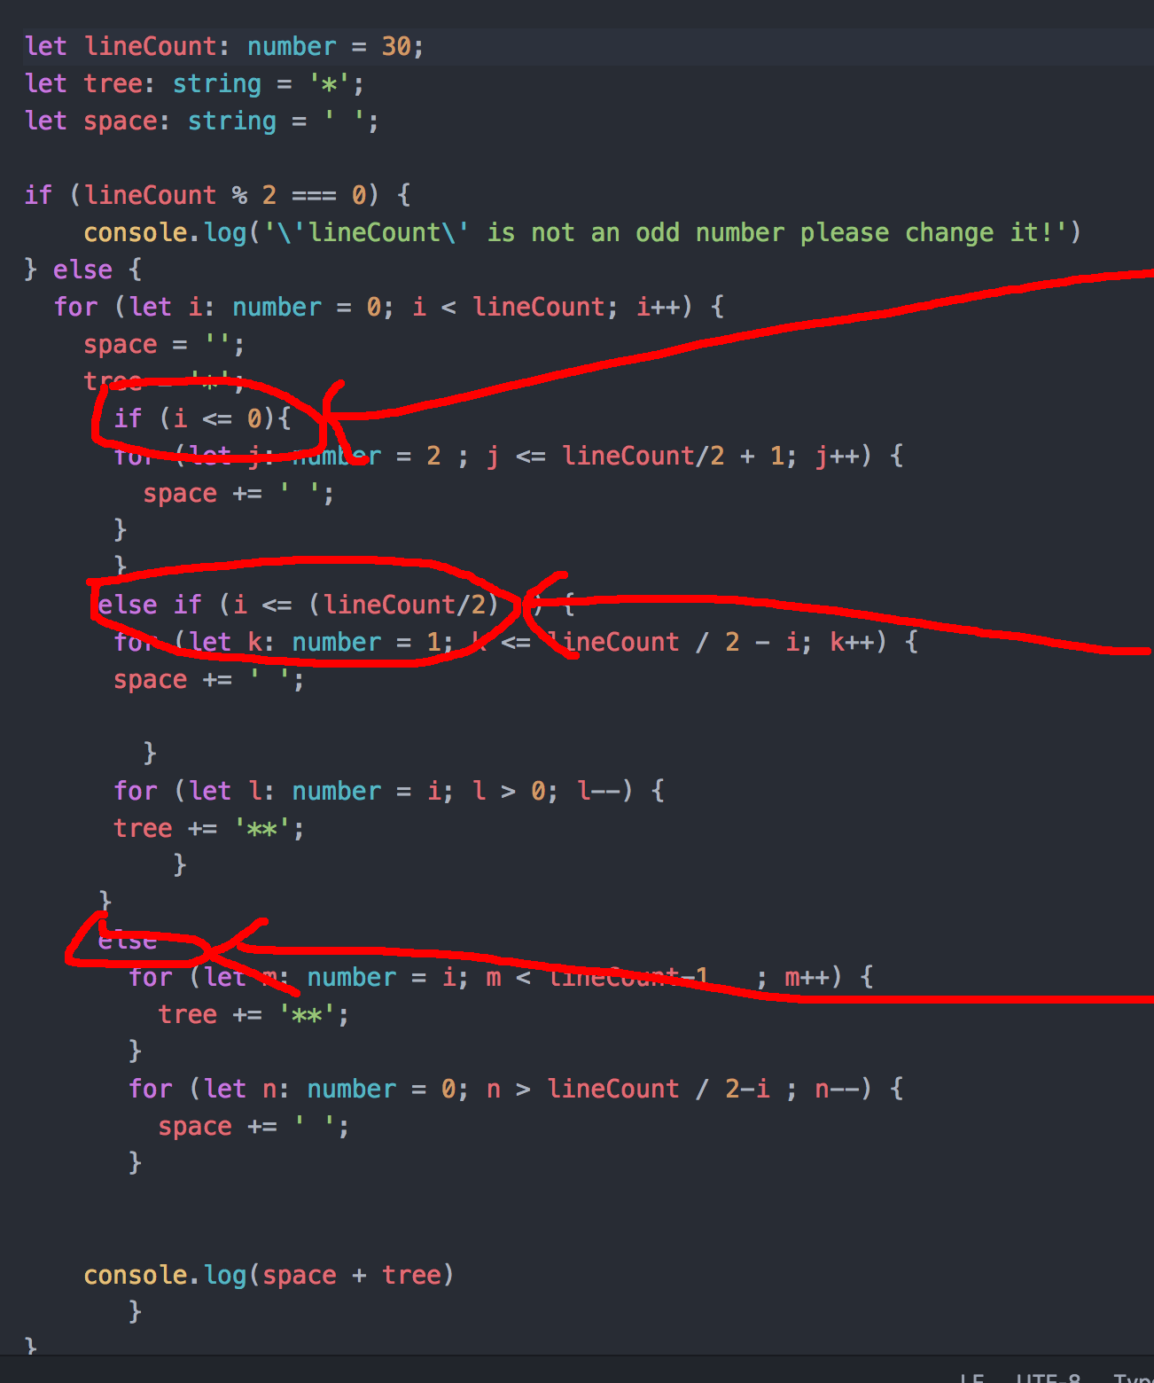
FIRST LINE OF THE DIAMOND
BODY OF THE DIAMOND
NARROW BOTTOM PART

Slide 15
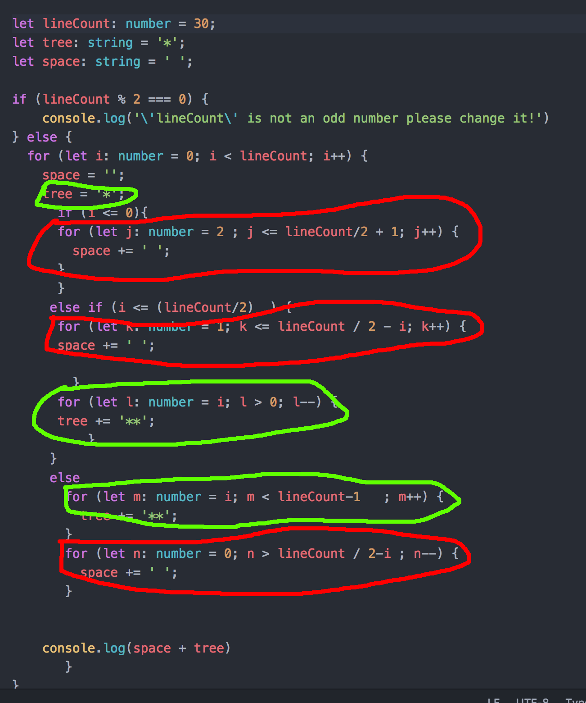
FOR LOOPS FOR WHITESPACE
FOR LOOPS FOR *

Slide 16
KOSZONOM

